Slide 1
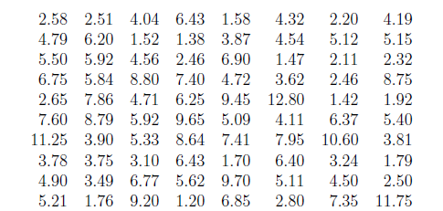
The following are the ignition times of certain upholstery materials exposed to a flame (given to the nearest hundredth of a second) Group these figures into a table with a suitable number of equal classes and construct a histogram.

Slide 2
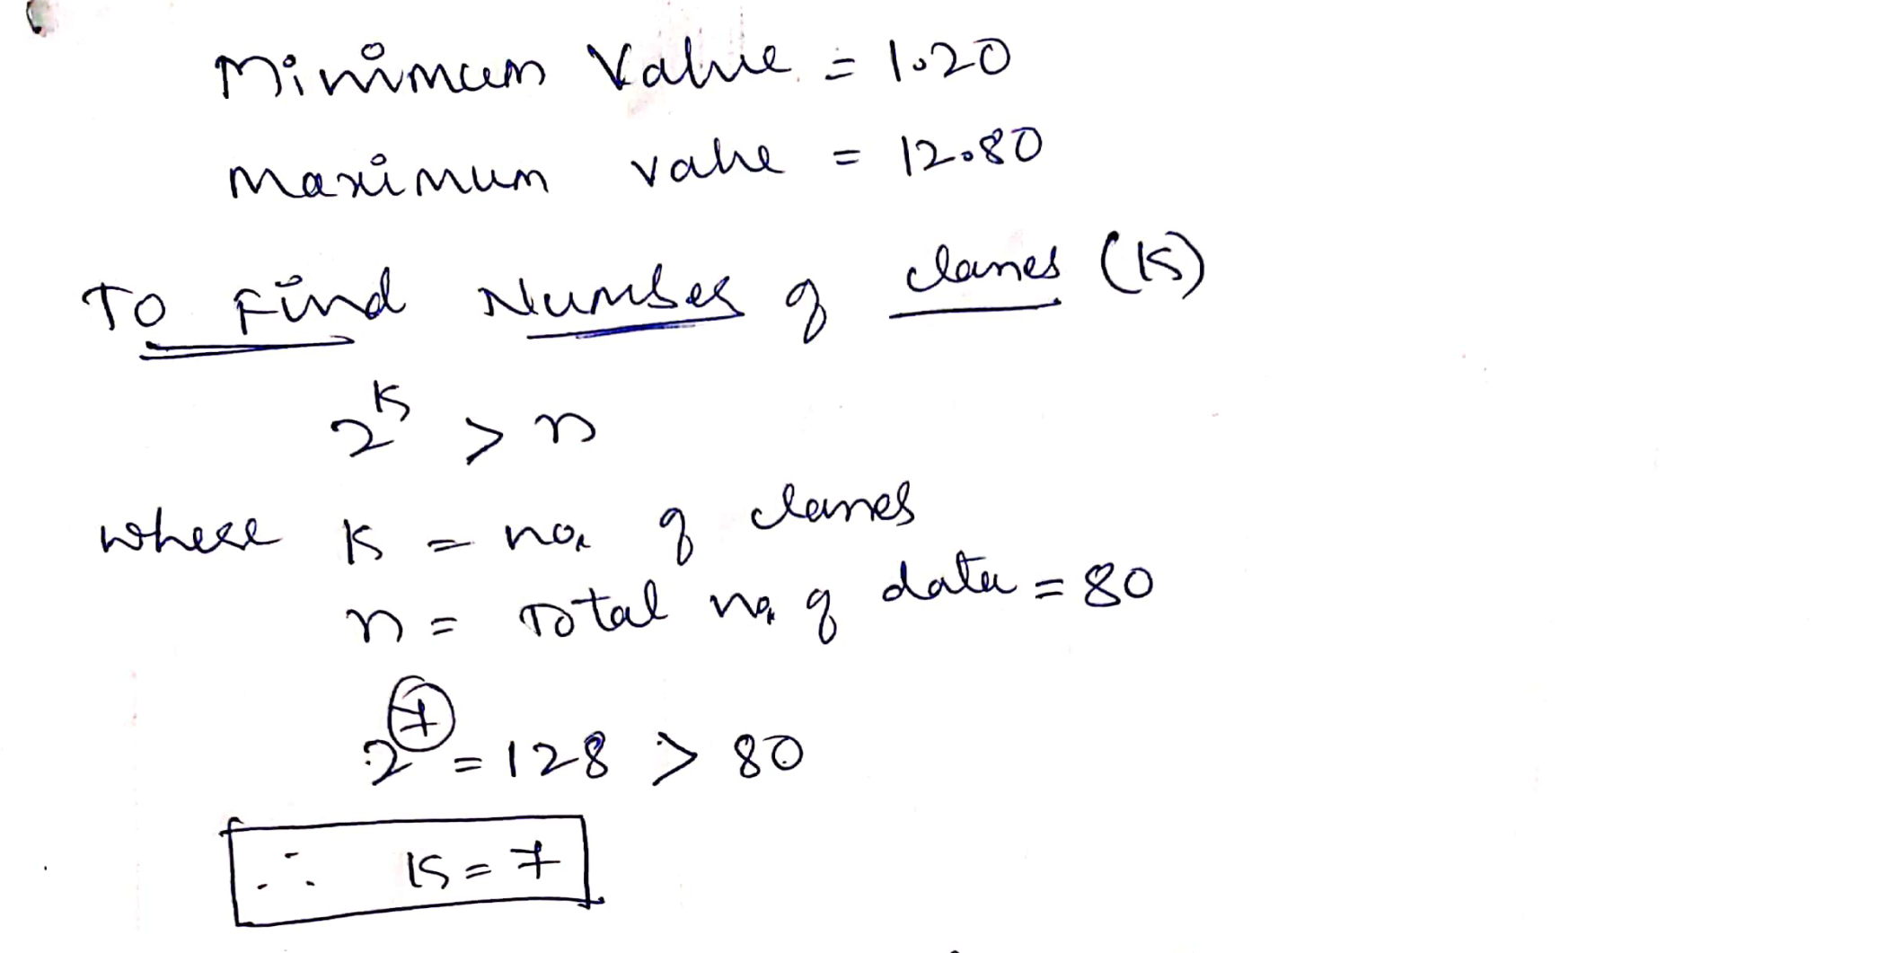

Slide 3
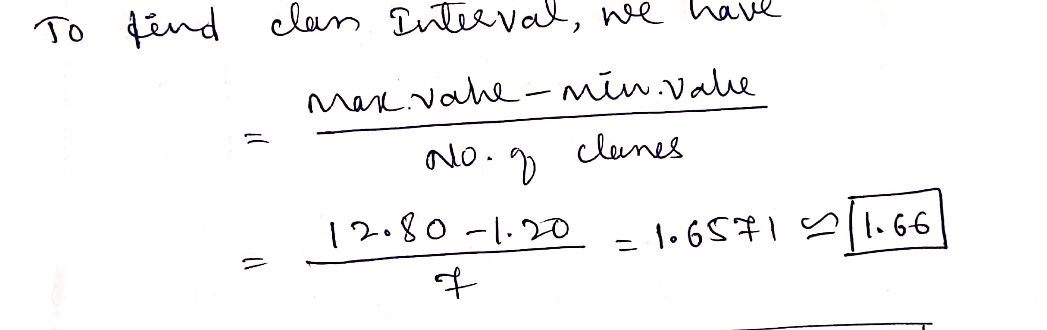

Slide 4
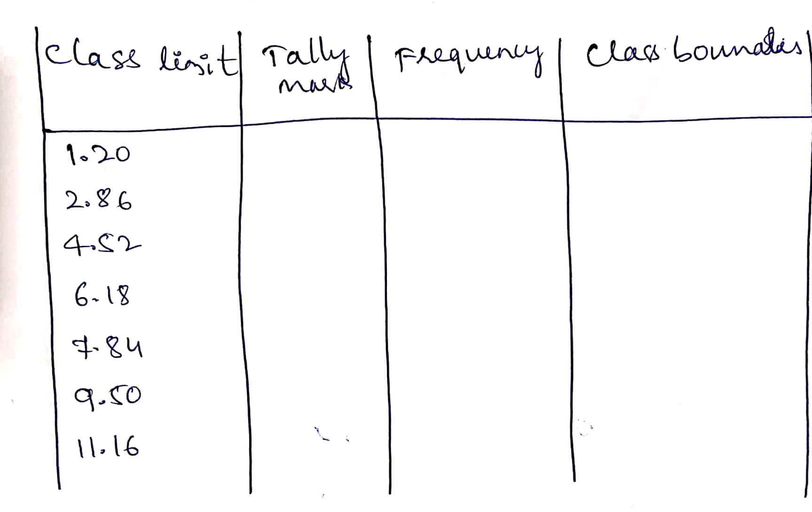
+1.66

Slide 5
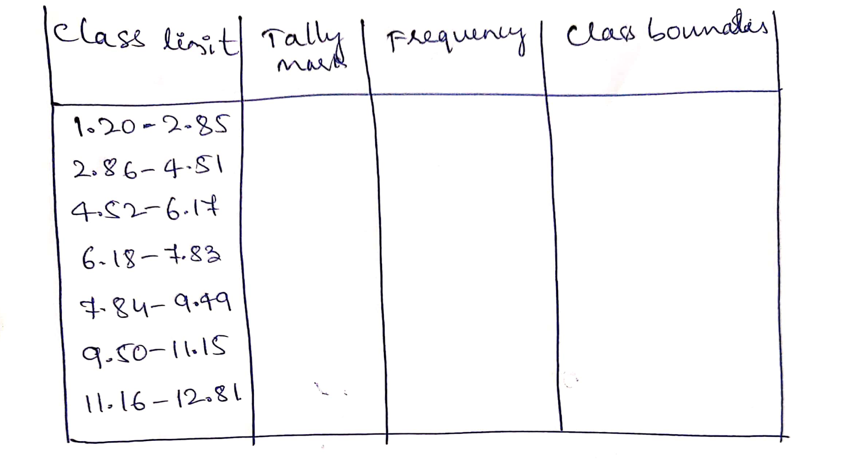

Slide 6
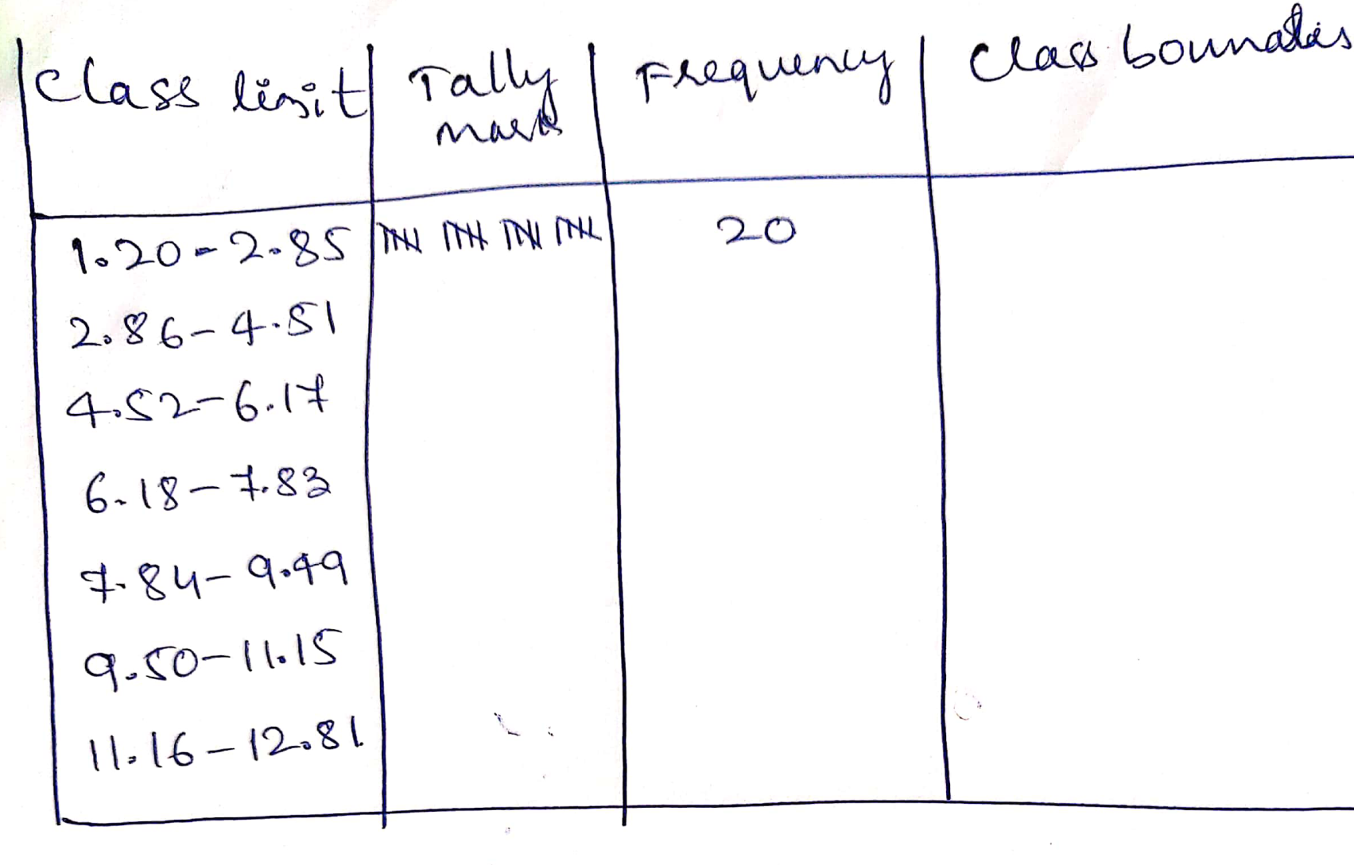

Slide 7
